Slide 1
FATIGUE OF MATERIALS & STRUCTURES
G. Hénaff
1

Slide 2
Fatigue of notched components

Slide 3
Notch effect
σ
2h
ρ
x
2a
⇒ The local stress at the notch root is higher than the gross stress

Slide 4
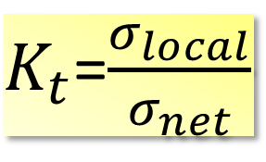
Stress concentration factor
Definition : ratio “local stress/ gross stress on the net section”
$K_{t}$=$\frac{σ_{local}}{σ_{net}}$
K_{t} :
- is defined within the framework of elasticity;
- Only depends on geometry, in particular the notch tip radius! (typically not on the constitutive law of the considered material)

Slide 5
Relation between K_{t}, K_{σ} and K_{ε}
K
,
K
K
t
ε ,
σ
>
K
>
K
K
ε
t
σ
K
ε
Elastic domain
Elasto-plastic
Domain
K
=
K
=
K
t
σ
ε
K
σ
σ
σ
y

Slide 6
Reduction in fatigue life
Notch effect on fatigue limit quantified by the K_{f} cœfficient :
Sensitivity to notch effect :
q=0: insensitive to notch effect;
q=1 : no adaptation (K_{f}=K_{t})

Slide 7
Determination of the q coefficient
“Material” Parameter
Mild steels: a=0,25mm
High strength steels: a=0,025mm
Peterson: m=1
Neuber: m=1/2

Slide 8
Determination of K_{f} or q

Slide 9
Application to Wöhler curves
The determination of K_{f} permits the prediction of the fatigue life of notched components on the basis of the Wöhler curve established on smooth samples.

Slide 10
Application to Wöhler curves
Data on smooth samples
Master curve

Slide 11
Neuber’s Rule
Problem: determine the local stress/strain amplitude at the notch root from the far field loading
→ simple solution in the framework of elasticity:
→ Idea: extrapolate the previous relation to the elasto-plastic domain
Still valid in the easto-plastic domain

Slide 12
Neuber’s Rule
Graphical solution of the equation:
σ
The solution also behaves to the constitutive law of the material
ε

Slide 13
Extension to cyclic loading

Slide 14
Equivalent Deformation Energy (EDE) criterion
Strain energy density in elasticity:
Hyp. : relation always satisfied in elasticity
Fictional elastic material
σ
σ
Actual material
≠
ε
ε
EDE : the two areas are equal
Neuber’s rule overestimates the local stress and strain

Slide 15
Comparison Neuber/EDE using Ramberg-Osgood constitutive law
EDE:
Neuber

Slide 16
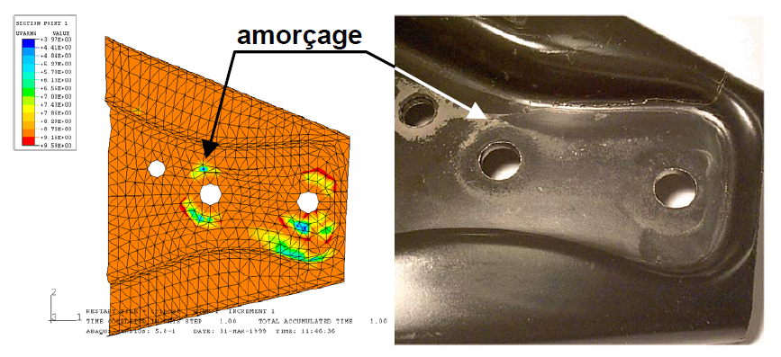
Application of Neuber’s rule : prediction of crack initiation in a suspension triangle
initiation

